Slide 1

I-Focus
Group 10-11 Samuel Leong 4S1(17)
Ryan Tan 4S1(21)
Walter Kong 4O3(33)
Xiao Songyuan 4S2(20)

Slide 2
Introduction
Notes:
The advent of mobile devices have revolutionised the way websites and interfaces are designed.
When we talk about user satisfaction, there are two important aspects.
One, the interface design. Some keywords are "responsive design" and the recent "material design".
Two, the interaction with the interface.
In our project, we take a relook on how we can best interact with our devices daily using the latest technology.
Good morning fellow judges and schoolmates. I am Walter.
Today, we're excited to share with you the findings of our research done with DSO and the implications of it.

Slide 3

Video

Slide 4

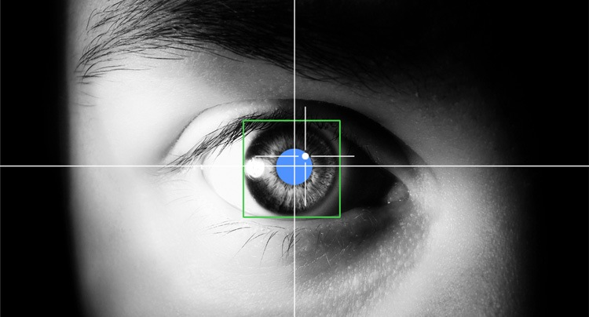
EFFICIENT.
Effective.
INTUITIVE.
Eye-tracking Look at where you want the cursor to move.
Multi-modal Input Eye-tracking + Click
Notes:
Before we begin, let us define some terms that we will be using alot.
Eye-tracking, refers to the cursor moving to where you look at.
and Multi-modal Input refers to a combination of different input forms, such as hand gesture, mouse or eye.

Slide 5
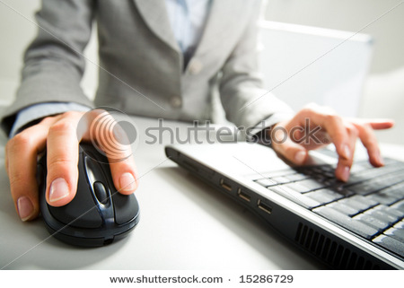
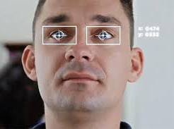
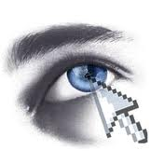

Why I-Focus?
Notes:
By experimenting with different multimodal approaches, we found the most natural way of interaction.
This is because the mouse isn't optimal for every function.

Slide 6

Target Audience
Physically Disabled
General Public
Notes:
Our project can potentially help physically disabled persons use a hands-free approach.
And it also contributes to the revolution of how we interact with our devices.
Songyuan will be sharing more on our method.

Slide 7
Objectives
Research
The Full Package
Gestures
Website
Games
Console App

Slide 8
Methodology

Slide 9
Timeline
Prelim Presentation
Semis Presentation
Finals Presentation
Prelim
Semis
Finals
Planning
Developmental
Implementation
Alpha Testing
Beta Testing
Extensions
Notes:
We’ve completed everything so far, including some of our extensions

Slide 10
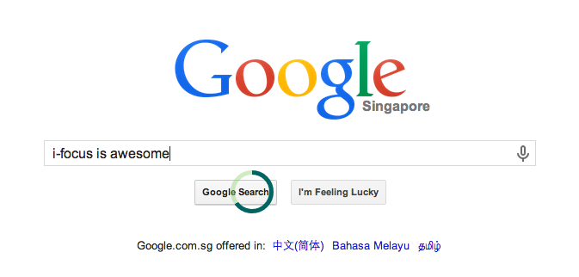
What’s been done so far...
Notes:
We have allowed our cursor to work on other sites, such as google, using a basic chrome extension

Slide 11
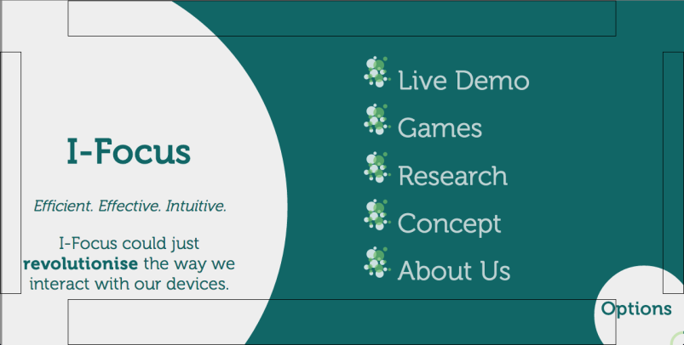
What’s been done so far...
Notes:
We have also uploaded our website to an online server for everyone to access

Slide 12
Application
Notes:
…so now presenting to you the application component of I-Focus

Slide 13



Input methods
Keyboard & Mouse
Eye-tracking (eye gestures)
Leap motion (hand gestures)
Notes:
These are the various input methods used in our project

Slide 14
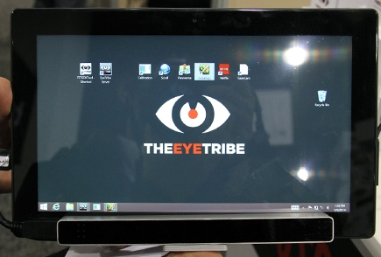
Devices
EyeTribe Eye-Tracker
Affordable · Accurate
Notes:
The device we would be using is the EyeTribe eye-tracker, which is affordable and a lot more accurate than webcams.

Slide 15
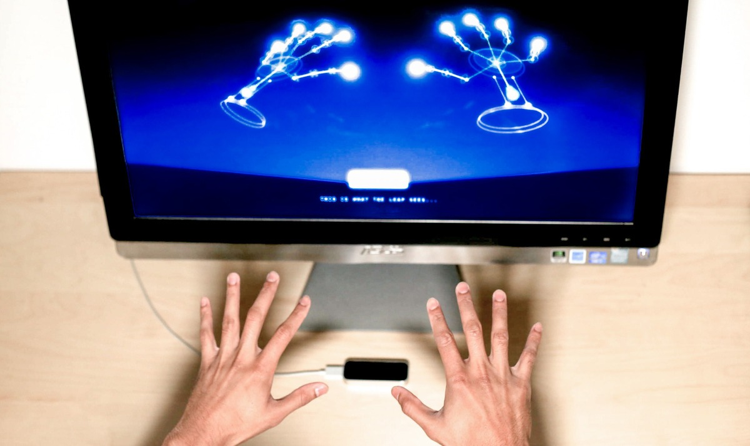
Devices
Leap Motion Hand Gestures
Physical Input
Notes:
The leap motion device is a device that tracks hand gestures and is used to sense physical input.

Slide 16
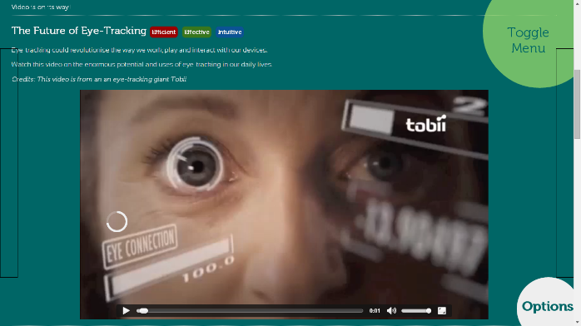
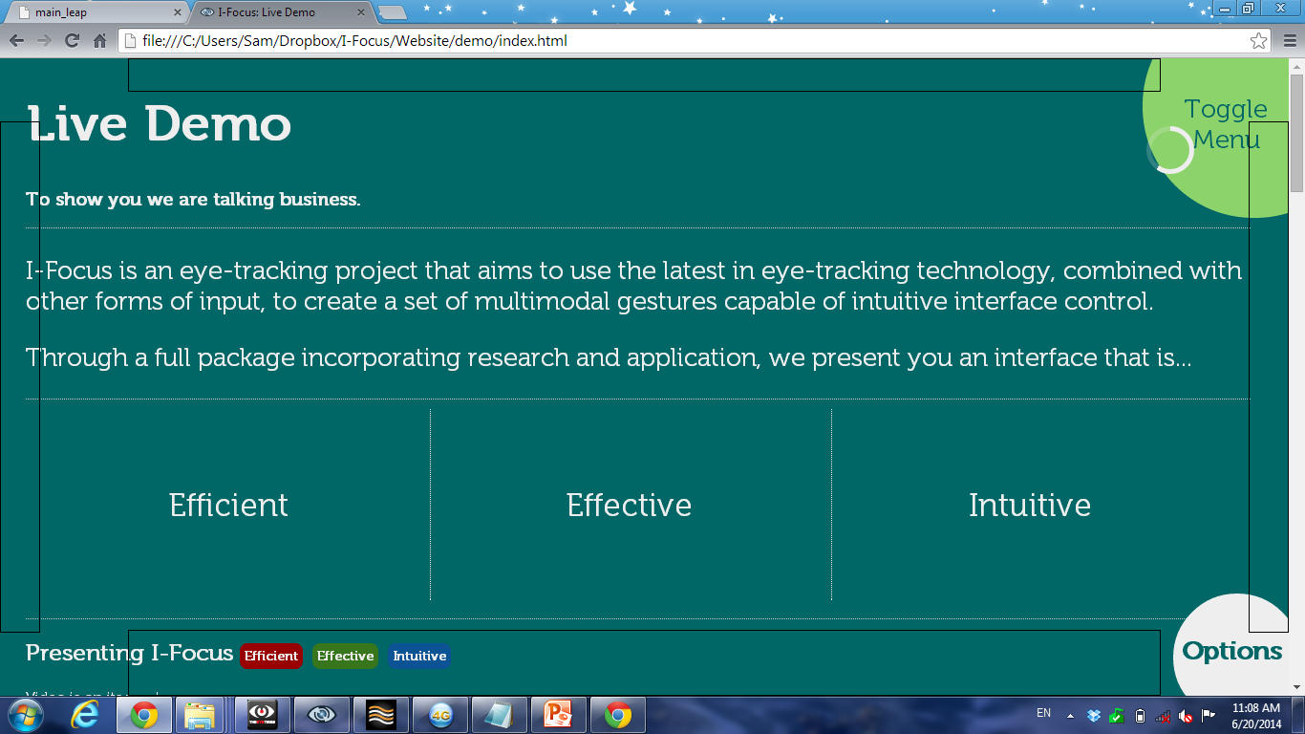
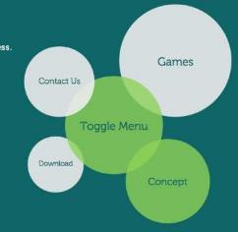
Features
Auto-scrolling
Modified Cursor
Video Control
Radial Menu
Notes:
So now for the most exciting part of the presentation… Seeing I-Focus in action…
Some of I-Focus’ features include an intuitive way to click, scroll, control videos and navigate..

Slide 17

Live Demo
Efficient.
Effective.
Intuitive.
Notes:
Now, eyes on the screen and its your turn to be live participant.
What we will be showing you first is a game that we used in our research to see which input method is most feasible for tracking and targeting tasks.
The objective of this particular game is to pan the screen and find the full cross.
Notice the difference between a mouse and the eye-tracker.
With the mouse it’s a 3 step process (as Ryan will demonstrate)
Find the target
Move the cursor to the target
Click
But with the eye-tracker, everything is so much faster because you are literally looking to where you want the cursor to go.
All you have to do is to look at the target and click on it, just like what Ryan is doing now.
See, efficient, effective and, as our participants have said, intuitive.
[Move to website]
But I-Focus is not restricted only to targeting tasks.
We want to showcase eye-tracking for day to day applications.
Our website in particular is perfect for our target audience the physically-disabled as it is completely hands free.
Our website is completely configurable using the options box as shown.
So to click all the user has to do is to look at a clickable area and an animated cursor will run. (Ryan please look at the Live Demo link) and once the animation completes, a click is triggered
Now as you can see we have a radial menu for user navigation. This is a new intuitive way for users to navigate as our research as shown. (Ryan please close the menu by looking at toggle menu.)
We give you an even more intuitive method to scroll. By looking at the bottom part of the page, we now you want to look on. (Ryan please look at the bottom of page)
And when you look up, it will scroll up.
(Ryan please scroll-up by looking at the top and then scroll down to the video)
When you look at a video, we know that you want to watch it. And when you look away, we know that you do not want to do so anymore and the video pauses.
So this is the semi-telepathic power of eye-tracking!
--------------------------------------------
During the semis, one of the judges commented that we should extend these functions to other websites and we have done that using a very basic chrome extension.
We have allowed our special animated cursor to work on any website, and we will demonstrate it to you know on the HCI website.
As you can see, this is done on an actual live webpage. As the cursor hovers over a link, you can see the animated cursor running and triggering a click. The same thing works on every page and also works for buttons.
With I-Focus, the physically disabled can know surf websites efficiently, effectively and intuitively.
------------------
What’s more, eye-tracking can be used by our target audience for efficient and effective typing using this freeware, Dasher.
Ryan will be typing a sentence with this program. This program is specially suited for eye-tracking and you can see how fast words can be typed. In fact, when we downloaded this software, it prompted us whether we would like to install the Tobii Eye-tracking software along with it.
Game (comparison)
Eye-tracking
Mouse
Website (features – for a purely hands-free interface for disabled)
Menu
Modified cursor
Auto-scroll
Video function

Slide 18
Research
Notes:
Now that you have seen for yourself how eye-tracking is applicable to our daily life, let us talk a bit about how we proved it using research with DSO.

Slide 19
Research Procedure
6 Live Participants
Website
Games
Notes:
We conducted an experiment on 6 live participants, all of whom were randomly chosen. Each participant was required to play a game and navigate through our website.

Slide 20
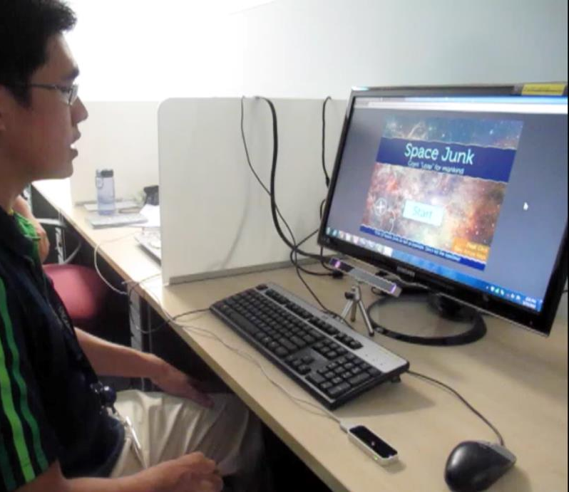
Participant
Big Screen
Eye-Tracker
Fixated Mouse
Leap Motion
Notes:
And this is our experimental set-up. There is a: ……

Slide 21


Results - Game
* Less time is better.
Notes:
The game (the one that we presented in the live demo) required participants to find 10 targets in the shortest time, so the lower the score, the better. Leap motion timings were off the charts, and all 6 participants ranked leap motion last. Also, we were pleasantly surprised to find that half the participants ranked eye-tracking to be 1st, while the other half chose the mouse, as can be seen from the icons at the top. Why is this so?

Slide 22

Comments
 | + Advantages | - Disadvantages
Eye-Tracking | Intuitive Very fast Better at targeting tasks | Jittery (inaccurate)
Leap Motion |  | Tiring Prone to errors
 | + Advantages | - Disadvantages

Slide 23
Results - Website
* QUIS survey. Higher is better.
Notes:
Participants were asked to navigate through 2 versions of the website and completed a QUIS survey, an industry standard survey that measures how well-received each version was to the participants.
These are the results obtained from the quiz, the higher the score, the better. Although the 2nd version had a better average score than the 1st, both versions seemed to be equally well-received by the participants.

Slide 24
Results - Website
Notes:
There were 3 participants who voted for each version.

Slide 25
Results - Website
Content
Most preferred radial menu as it was larger
5/6 participants preferred kinesthetic clicks
Modified cursor was considered more ineffective and too frustrating
Inaccuracy Issue
But, modified cursor scores were consistently above 5 (out of 9).
* QUIS survey used. Higher the scores, the better.
Notes:
These are some of our qualitative findings. Most preferred the radial menu as it was larger, 5 out of 6 participants preferred kinesthetic clicks as the modified cursor seemed more ineffective and frustrating since the eye-tracker is limited in terms of accuracy

Slide 26
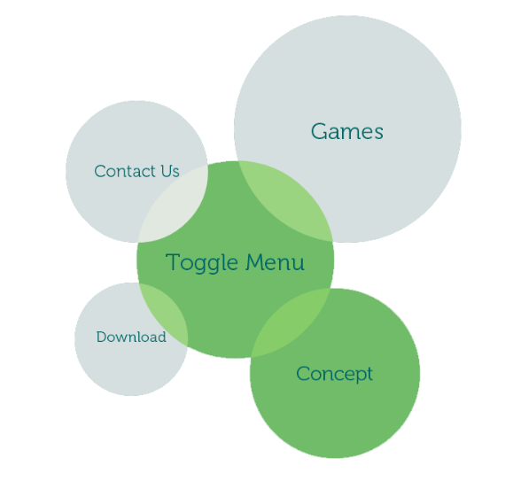
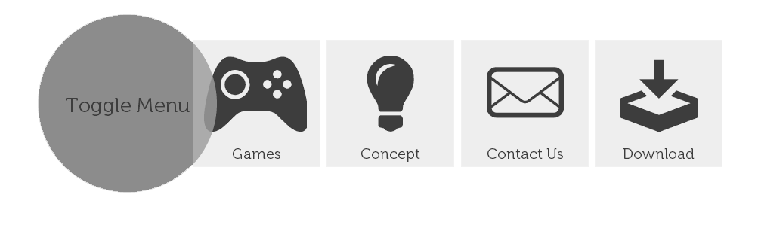
Results - Website

Slide 27
Results - Website

Slide 28
Findings - Website
Video function should
Optional
Buffer time before pause
Reduce timer
Cursor
Moving while reading is irritating
Should disappear while over text
Interface elements should
Larger
More obvious
COMPLETE
Notes:
These are some of the changes we’ve decided to make corresponding to the research results.
[They are mainly to the video function, modified cursor, and selectable objects]

Slide 29
Summary
Once eye-tracker is accurate enough,
Eye-tracking beats the mouse in terms of…
Efficient Very Fast
Effective Targeting & Tracking tasks
Intuitive Natural
Notes:
So in the culmination of our research, it is shown that once an affordable eye-tracker with sufficient accuracy surfaces in the market, eye-tracking will beat the mouse in terms of speed and efficiency especially for targeting and tracking tasks, and have improved overall intuitiveness. There you have it, efficient, effective, intuitive. Our hypothesis proves true.

Slide 30

Looking to the Future...
Improving the Input Methods
Sound input > physical input
Improving Accuracy
Head tracking to mitigate precision
Improve Interface
Further Research
More input combination for different functions

Slide 31
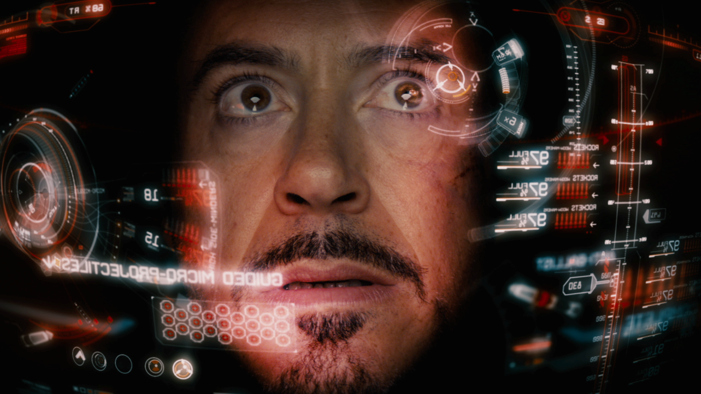
Thank You!
Notes:
“More than meets the eye”
“… in the blink of an eye”
“Look!”
“Don’t blink!”

